Slide 1
Stochastic programming and robust optimisation
Prof. Fabricio Oliveira (MS/SCI)
Kick-off session
EV-0017
06.09.2023

Slide 2

Outline
Course overview
Course organisation
Lectures
Paper presentations
Projects
Course assessment
Set dates
Lectures content

Slide 3
Introductions

Slide 4
Introductions
Please let us know:
Your prefered name
MSc or DSc?
Major (if MSc) or Dept. & School and Supervisor (if DSc)

Slide 5
Course overview

Slide 6
Course overview
Part I
Lectures
2/3 – Lecture
1/3 – Guided tutorial
Part II
Seminars
Article of your choice
Project presentations
Application of your choice

Slide 7
Course organisation

Slide 8
Administratrivia
Sessions: Wednesday 9.15 am @ Y405
People:
- Lecturer: Fabricio (fabricio.oliveira@aalto.fi)
- TA: Paula (paula.weller@aalto.fi)
Support:
- MS Teams (Mon-Fri, 9-5) or Email: for short questions and bookings
- (Video) meetings: bookable in advance (no fixed office hours)
“Technical support”: Paula
Projects and papers: Fabricio

Slide 9
Lectures & tutorials
Topics we will cover:
Two- and multi-stage stochastic programming
Scenario generation and sample average approximation (SAA)
Chance constraints and risk measures
Decomposition methods (Progressive Hedging and SDDP)
Static and adaptive robust optimisation
Tutorial: guided demos using Julia with examples and applications related to the topics presented.

Slide 10
Seminars
You are expected to give a presentations on a paper of your choice
Learning based to a large extent on the classroom discussion
Format: conference presentation: 25 + 5 minutes
Use slides (+ whiteboard if you wish)
Practice a few times beforehand to control time
Some time control tips:
- Number slides (e.g., 2/25 – current slide/total slides)
- Break presentation in sections and know your target time stamps
Language: English

Slide 11
Projects
You are also expected to develop a practical application project
Main requirement: employ one or more of the ideas discussed in the lectures
Topic of your choosing
Deliverables: oral presentation, slides, and code
Ideas
Choose a textbook problem and develop a version of it under uncertainty
Apply seen techniques to a problem of your own choice
Replicate/extend computational experiments from a article (can be, e.g., the same presented)

Slide 12
Course assessment

Slide 13
Grading principles
Participation: 20pt
Proportional to attendance
Present 80% (8/10) of contact sessions = 20pt
Otherwise proportional
Research paper presentation: 30pt
Presentations anonymously graded by peers (1-5)
Average of peer grades x 6.

Slide 14
Grading principles
Project: 50pt (graded by me)
Criteria
Appropriate choice of techniques
Depth of analysis
Main conclusions
Presentation should cover in 25 + 5 minutes:
Project scope and hypotheses (research question)
Main conclusions (supported by numeric evidence)

Slide 15
Set the dates

Slide 16
Important dates
Choice of paper for seminar part: Friday 13.10.2023
Definition of project topic: Friday 03.11.2023
Seminar presentations
25.10.2023 | 01.11.2023 | (08.11.2023)
Project presentations
15.11.2023 | 22.11.2023 | (29.11.2023)

Slide 17
Lectures content

Slide 18
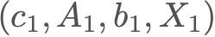

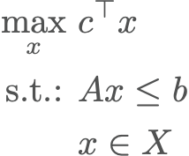
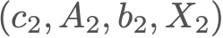
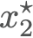

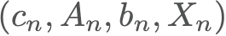
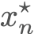
Optimisation under uncertainty
Mathematical programming-based methods are not able to explicitly consider uncertainty in their evaluations.
Notes:
Presumes fixed input data;
For each input, one solution - sensitivity analysis, what-if analysis…;
Do you see a problem here?
What are we supposed to do with a set of strategies at hand? (if the first idea was to get a single optimal one!)
What good does it make to know the best strategy after the future unveils?

Slide 19
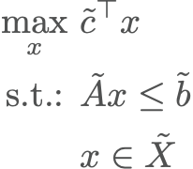

Optimisation under uncertainty
To be useful, a unique strategy must be defined beforehand for meaningful decision making.
Redraw
Notes:
Decisions have to be made today!
We can’t wait to see the future and use our time machine to go back and make the right choice (yet).
However, the decision-maker needs a single strategy.
How can we bring this uncertainty about the future to our optimisation problems?

Slide 20
K-stage problems under uncertainty
Stage 1
Stage 2
Stage 3
Basic steps:
Break time flow into points of interest;
Gather decisions that must be made at each point;
Explicitly represent scenarios.
Decide 3
Decide 2
Decide 3
Decide 3
Decide 3
Decide 1
Decide 2
Decide 3
Decide 1
Decide 3
Decide 3
Decide 2
Decide 3
Decide 3
Time flow
Notes:
In many cases, only part of the decisions must be taken before the uncertainty unveils. Postponement = more information!
At each uncertainty realisation, we have more information available. Each of those points of interests are called stages.
Having the possibility of postponing decisions is the essence behind the benefits of bringing uncertainty into our optimisation models.
Those are often called recourse decisions.
One can have as many stages as wanted, but Multi-stage problems are known for computationally challenging;
In most cases, it is possible to approximate then by means of 2-stage problems and rolling horizon strategies;
In some cases it is a necessary evil. Promising field of research at the moment.

Slide 21
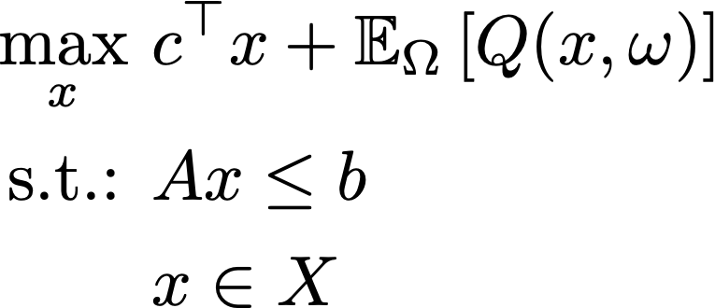
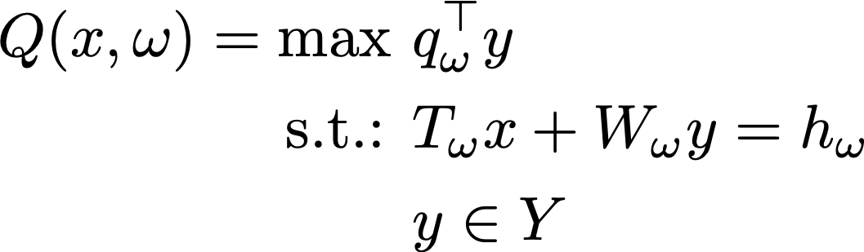
2-stage problems under uncertainty
In a two-stage setting, we have the following:
where
Notes:
Keeping it simple, let’s have a look at the 2 stage case.
We will divide our decisions into two distinct block: "here-and-now" and “wait-and-see”.
Let:
x – first-stage decision must be made here and now.
y – second-stage decisions can be made later on.
Ω – our “future”, sort of speaking (aka probability space with well defined moments and probabilities)
In this case, we can formulate our so-called stochastic model as presented.
———
Q(x,\omega) = \max &q_\omega^\top y \\
\text{s.t.: } & T_{\omega}x + W_{\omega}y = h_{\omega} \\
& y \in Y
\max_x \ &c^\top x + \mathbb{E}_{\Omega}\left[ Q(x,\omega)\right] \\
\text{s.t.: }& Ax \leq b \\
& x \in X

Slide 22
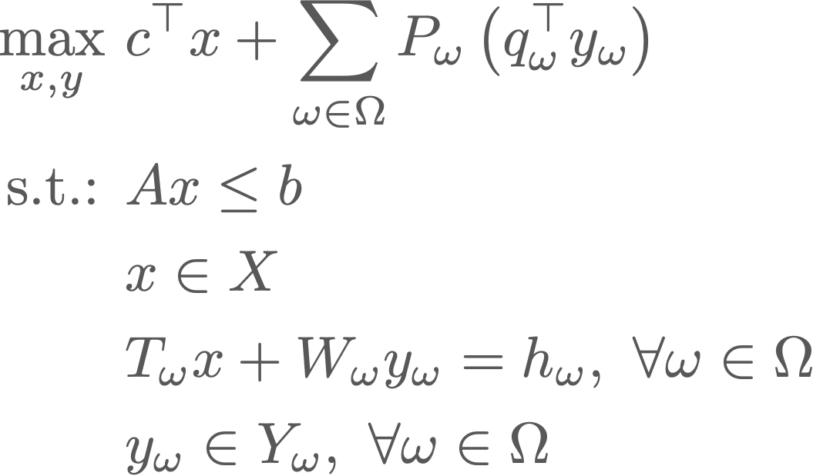
2-stage problems under uncertainty
Which is in turn is (deterministically) equivalent to
Notes:
Keeping it simple, let’s have a look at the 2 stage case.
We will divide our decisions into two distinct block: "here-and-now" and “wait-and-see”.
Let:
x – first-stage decision must be made here and now.
y – second-stage decisions can be made later on.
Ω – our “future”, sort of speaking (aka probability space with well defined moments and probabilities)
In this case, we can formulate our so-called stochastic model as presented.
———
Q(x,\omega) = \max &q_\omega^\top y \\
\text{s.t.: } & T_{\omega}x + W_{\omega}y = h_{\omega} \\
& y \in Y
\max_x \ &c^\top x + \mathbb{E}_{\Omega}\left[ Q(x,\omega)\right] \\
\text{s.t.: }& Ax \leq b \\
& x \in X

Slide 23
Modelling problems under uncertainty
There are 4 main aspects that must be considered for this framework to be meaningful:
How to sync decisions and uncertain events?
How to generate good discrete representations?
Risk tolerance profiles?
Can we solve these problems?
2-stage deterministic equivalent problem
Notes:
In practical terms, a discrete set of scenarios is made available, as well as their occurrence probability p_\omega.
Such a discrete approximation of the stochasticity allows as to formulate so-called deterministic equivalents, which are large-scale mathematical programs with a very particular structure.
Exploiting the block-angular structure is the core idea for all successful decomposition approaches for solving these problems.
———
\max_{x,y} \ &c^\top x + \sum_{\omega \in \Omega}p_{\omega}\left(q_\omega^\top y_{\omega}\right) \\
\text{s.t.: }& Ax \leq b \\
& x \in X \\
&T_{\omega}x + W_{\omega}y_{\omega} = h_{\omega}, \forall \omega \in \Omega \\
& y_\omega \in Y_{\omega}, \forall \omega \in \Omega

Slide 24
Optimisation under uncertainty
A general toolset that requires full consideration of four aspects:
Time flow modelling
Optimisation under Uncertainty
(Stochastic Programming + Robust Optimisation)
Scenario Generation
Decision
Risk profile
Solution method

Slide 25


